Slide 1

TASK-3
Predictive Modeling
SATISH NAGAR
DATA SCIENCE INTERN
AT HACKVEDA

Slide 2






Slide 3




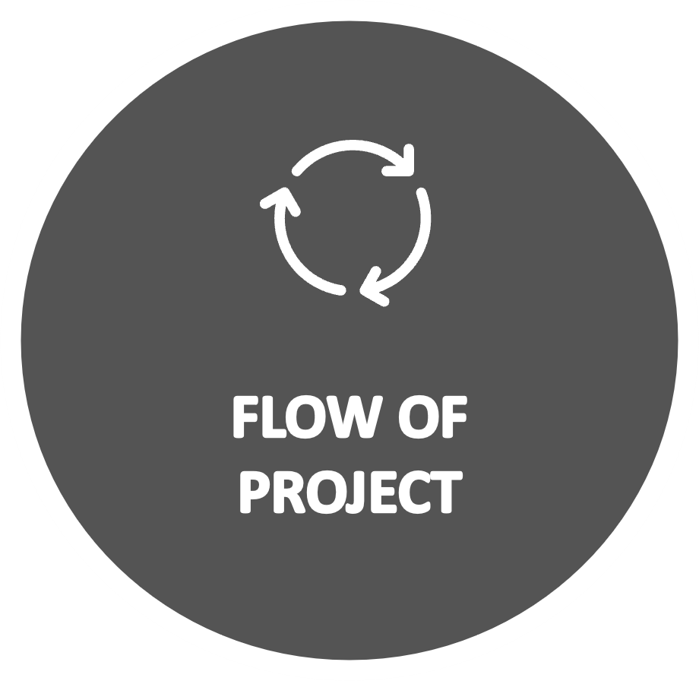

Slide 4



HOOK-STORY

Slide 5


Diverse Learners
Every student has unique backgrounds, learning styles, and challenges.
STORY
Identifying Struggles
Priya, a hardworking student, struggles with math, and her teachers need to understand why.
Predictive Modeling
A tool that analyzes factors like study habits, family support, and preparedness to predict performance.

Slide 6
Actionable Insights
Identifies reasons for struggles and suggests solutions to help students improve.
STORY
Proactive Support
ses data patterns and machine learning to assist teachers in guiding students effectively.
Empower
-ing Educators
Helps make informed decisions and creates more student success stories.

Slide 7

Understand Challenges: Finds out why students face difficulties in certain subjects.
Predict Outcomes: Estimates how students will perform in the future.
HOOK
Provide Solutions: Suggests ways to help students improve.
Support Educators: Turns data into useful insights for teachers.
Early Intervention: Identifies problems early to prevent students from falling behind

Slide 8

Objective: To develop a predictive model using machine learning algorithms to forecast students' math scores based on demographic and preparation factors, enabling educators to identify key predictors and provide targeted support for improved academic outcomes.
OBJECTIVE

Slide 9

Introduction: This project uses machine learning to predict students' math scores based on factors like background and preparation. By analyzing the "Student Performance" dataset, we aim to identify key predictors and provide insights to help educators support students effectively.
INTRODUCTION

Slide 10

Data Source Overview: The dataset used for this project is the "Student Performance" dataset from Kaggle. It contains information on students' academic performance, focusing on math, reading, and writing scores.
DATA SET OVERVIEW
Key Features:
Demographics: Gender, race/ethnicity.
Parental Background: Parental level of education.
Resources: Lunch type (standard/reduced).
Preparation: Test preparation course status.
Target Variable: Math score.

Slide 11
FLOW OF PROJECT
Importing required
libraries
Dataset details
Detection of Missing values
Discriptive statistics
Predictive
Modeling
Algorithm‘s
Feature
Selection
Data visualization
Evaluation

Slide 12



Project implementation
Jupyter notebook
Dataiku

Slide 13

Conclusion
This project used machine learning to predict math scores based on key factors like demographics and preparation. The insights gained can help educators provide targeted support, improving student performance and outcomes through data-driven decisions.
Conclusion

Slide 14

Kaggle (https://www.kaggle.com/spscientist/students-performance-in-exams)
Youtube https://www.youtube.com/watch?v=LRW4ihwUnHo&t=35s
Chatgpt
https://chatgpt.com/
Reference

Slide 15




For any queries,
feel free to reach out at
Contact
satishnagar248@gmail.com
www.linkedin.com/in/satish-nagar-nilu

Slide 16
Thank-you ☺

